Slide 1
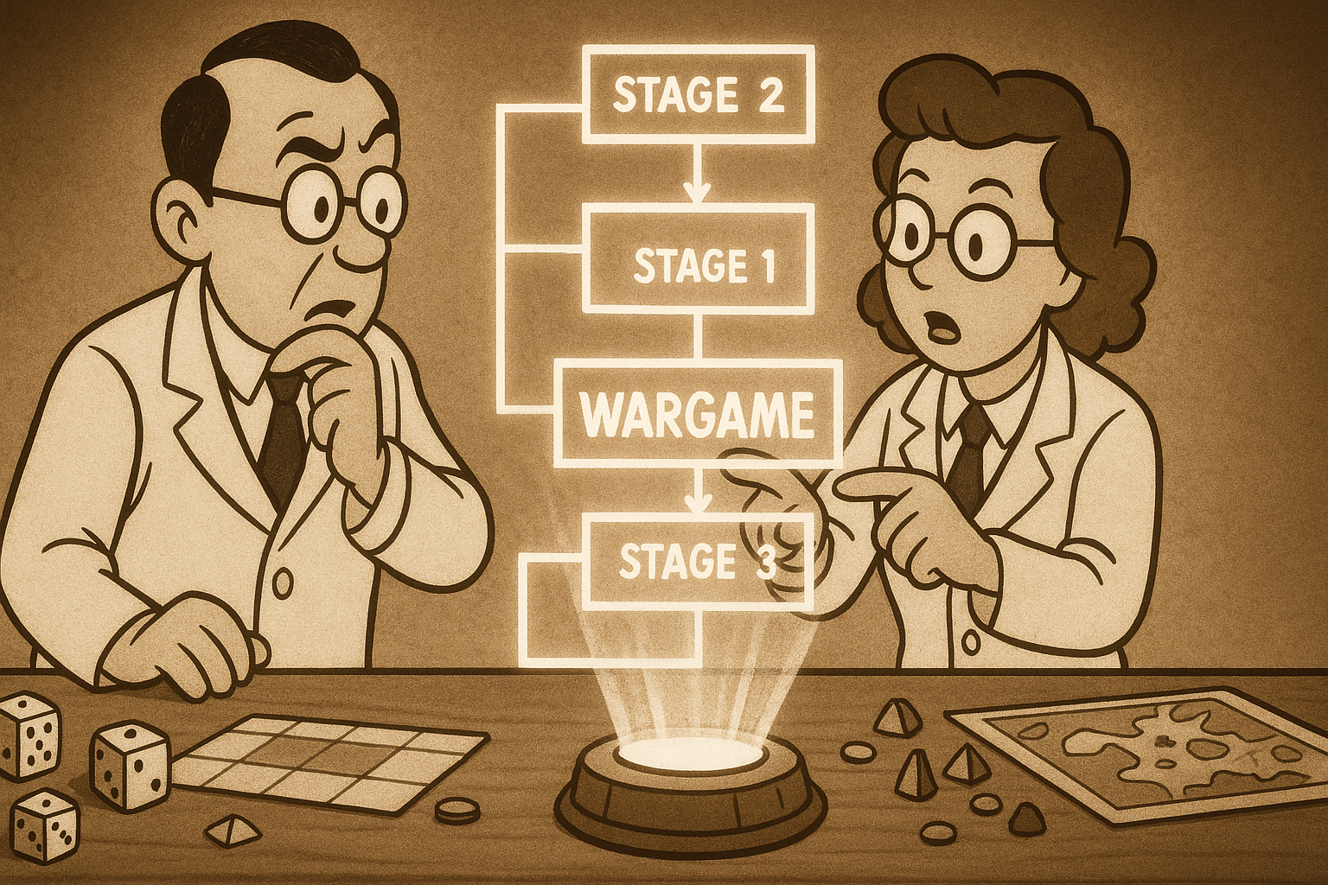
The Analysis-led Wargaming Framework
Dr James Bennett

Slide 2
1) Analysis-Led Wargaming Framework
1) Discover & Define
2) Design Development
3) Execute
4) Analyse
5) Report
Milestones: ICM, CDM, FCM, Sign Contract, Funding Gate 1
Milestones: Progress Reviews, Playtests, Funding Gates
Milestones: Rehearse, Conduct (Collect)
Milestones: Present Findings
Milestones: Deliver Report
Commission: Aim, Purpose, Objectives, Timescale, Required Level of Assurance, Expectations, Responsibilities, Reporting, and Exploitation
Create & Refine: Ruleset, Model, Simulation, Adjudication, Processes, Components, Scenario, Roles, Data Capture & Analysis Plan
Identify: Participants, Venue, Tools, Technology
Iterate: Playtests increasing in complexity
Run Wargaming Activity: Rehearse, Conduct
Carry Out: After Action Review
Generate First Impressions: Unverified observations derived from initial review of raw data
Generate Findings: Verified outputs derived from the analytical approach
Deliver: Post Exercise Report
Commission: Aim, Purpose, Objectives, Timescale, Required Level of Assurance, Expectations, Responsibilities, Reporting, and Exploitation
Create & Refine: Ruleset, Model, Simulation, Adjudication, Processes, Components, Scenario, Roles, Data Capture & Analysis Plan
Identify: Participants, Venue, Tools, Technology
Iterate: Playtests increasing in complexity
Run Wargaming Activity: Rehearse, Conduct
Carry Out: After Action Review
Deliver Report: Present finalised findings, approach, methodology, and necessary caveats
Conduct: Literature Review,
Games Review, Knowledge Survey, Lessons Survey
Identify: Gap or Problem in Understanding
Propose: Candidate Research Question (RQ) or Puzzle (RP)
Confirm: RQ or RP can be addressed by game
Create: Hypotheses or expectations
Identify and Confirm: Analytical approach and collection methods
Source: Required SQEP (Blue and Red)
Collect: Employ data collection methods
Assess: Employ analytical approach to collected data, moderate results, re-analyse to determine outputs
Verify Findings: Relate to RQ/P, Lit Review and/or Knowledge Survey and/or Lessons
(TTX)
Identify: Appropriate assurance approach to ensure wargaming activity is fit for purpose, using either the Evidence Framework Approach (EFA) or Validity Framework Approach (VFA)
Benchmark: Use selected approach to assess required quality, validity, and confidence levels
Quality Assessment: Ensure accurate and comprehensive data are collected
Evaluate: Assess potential bias in outcomes by reviewing scenario diversity and credibility
Review: Present preliminary findings to Commissioner for validation
Assurance: Use selected approach to evaluate final quality, validity, and confidence levels
Refine
Impact
Evaluate Design: Identify lessons that could improve future wargame designs
Incorporate: Action lessons identified
Commissioner's Responsibility
Define: Exploitation route and execute
Assess: Impact/value-added by output
Delivery Activities
Analysis Activities
Assurance Activities
Note: Some activities and milestones may only apply to large-scale wargames

Slide 3
1) Analysis-Led Wargaming Framework
1) Discover & Define
2) Design Development
3) Execute
4) Analyse
5) Report
Milestones: ICM, CDM, FCM, Sign Contract, Funding Gate 1
Milestones: Progress Reviews, Playtests, Funding Gates
Milestones: Rehearse, Conduct (Collect)
Milestones: Present Findings
Milestones: Deliver Report
Commission: Aim, Purpose, Objectives, Timescale, Required Level of Assurance, Expectations, Responsibilities, Reporting, and Exploitation
Create & Refine: Ruleset, Model, Simulation, Adjudication, Processes, Components, Scenario, Roles, Data Capture & Analysis Plan
Identify: Participants, Venue, Tools, Technology
Iterate: Playtests increasing in complexity
Run Wargaming Activity: Rehearse, Conduct
Carry Out: After Action Review
Generate First Impressions: Unverified observations derived from initial review of raw data
Generate Findings: Verified outputs derived from the analytical approach
Deliver: Post Exercise Report
Commission: Aim, Purpose, Objectives, Timescale, Required Level of Assurance, Expectations, Responsibilities, Reporting, and Exploitation
Create & Refine: Ruleset, Model, Simulation, Adjudication, Processes, Components, Scenario, Roles, Data Capture & Analysis Plan
Identify: Participants, Venue, Tools, Technology
Iterate: Playtests increasing in complexity
Run Wargaming Activity: Rehearse, Conduct
Carry Out: After Action Review
Deliver Report: Present finalised findings, approach, methodology, and necessary caveats
Conduct: Literature Review,
Games Review, Knowledge Survey, Lessons Survey
Identify: Gap or Problem in Understanding
Propose: Candidate Research Question (RQ) or Puzzle (RP)
Confirm: RQ or RP can be addressed by game
Create: Hypotheses or expectations
Identify and Confirm: Analytical approach and collection methods
Source: Required SQEP (Blue and Red)
Collect: Employ data collection methods
Assess: Employ analytical approach to collected data, moderate results, re-analyse to determine outputs
Verify Findings: Relate to RQ/P, Lit Review and/or Knowledge Survey and/or Lessons
(TTX)
Identify: Appropriate assurance approach to ensure wargaming activity is fit for purpose, using either the Evidence Framework Approach (EFA) or Validity Framework Approach (VFA)
Benchmark: Use selected approach to assess required quality, validity, and confidence levels
Quality Assessment: Ensure accurate and comprehensive data are collected
Evaluate: Assess potential bias in outcomes by reviewing scenario diversity and credibility
Review: Present preliminary findings to Commissioner for validation
Assurance: Use selected approach to evaluate final quality, validity, and confidence levels
Refine
Impact
Evaluate Design: Identify lessons that could improve future wargame designs
Incorporate: Action lessons identified
Commissioner's Responsibility
Define: Exploitation route and execute
Assess: Impact/value-added by output
Delivery Activities
Analysis Activities
Assurance Activities
Note: Some activities and milestones may only apply to large-scale wargames

Slide 4
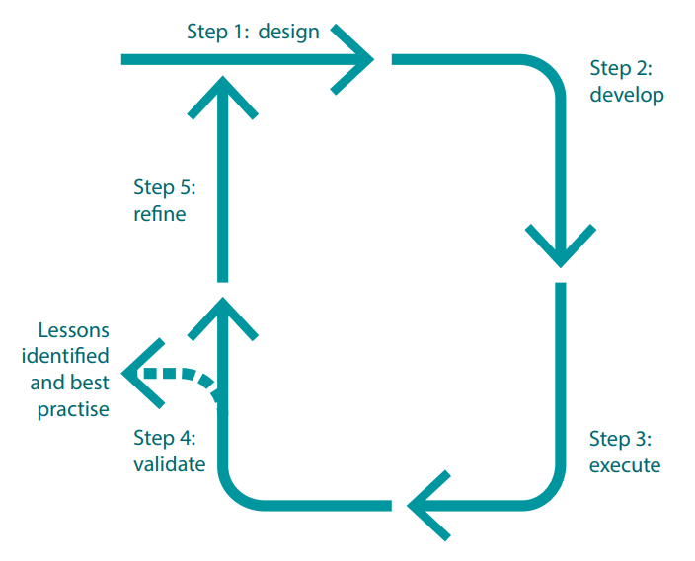
1) Analysis-Led Wargaming Framework
1) Discover & Define
2) Design Development
3) Execute
4) Analyse
5) Report
Milestones: ICM, CDM, FCM, Sign Contract, Funding Gate 1
Milestones: Progress Reviews, Playtests, Funding Gates
Milestones: Rehearse, Conduct (Collect)
Milestones: Present Findings
Milestones: Deliver Report
Commission: Aim, Purpose, Objectives, Timescale, Required Level of Assurance, Expectations, Responsibilities, Reporting, and Exploitation
Create & Refine: Ruleset, Model, Simulation, Adjudication, Processes, Components, Scenario, Roles, Data Capture & Analysis Plan
Identify: Participants, Venue, Tools, Technology
Iterate: Playtests increasing in complexity
Run Wargaming Activity: Rehearse, Conduct
Carry Out: After Action Review
Generate First Impressions: Unverified observations derived from initial review of raw data
Generate Findings: Verified outputs derived from the analytical approach
Deliver: Post Exercise Report
Commission: Aim, Purpose, Objectives, Timescale, Required Level of Assurance, Expectations, Responsibilities, Reporting, and Exploitation
Create & Refine: Ruleset, Model, Simulation, Adjudication, Processes, Components, Scenario, Roles, Data Capture & Analysis Plan
Identify: Participants, Venue, Tools, Technology
Iterate: Playtests increasing in complexity
Run Wargaming Activity: Rehearse, Conduct
Carry Out: After Action Review
Deliver Report: Present finalised findings, approach, methodology, and necessary caveats
Broadly applicable to wargames for a range of purposes
Conduct: Literature Review,
Games Review, Knowledge Survey, Lessons Survey
Identify: Gap or Problem in Understanding
Propose: Candidate Research Question (RQ) or Puzzle (RP)
Confirm: RQ or RP can be addressed by game
Create: Hypotheses or expectations
Identify and Confirm: Analytical approach and collection methods
Source: Required SQEP (Blue and Red)
Collect: Employ data collection methods
Assess: Employ analytical approach to collected data, moderate results, re-analyse to determine outputs
Verify Findings: Relate to RQ/P, Lit Review and/or Knowledge Survey and/or Lessons
(TTX)
Identify: Appropriate assurance approach to ensure wargaming activity is fit for purpose, using either the Evidence Framework Approach (EFA) or Validity Framework Approach (VFA)
Benchmark: Use selected approach to assess required quality, validity, and confidence levels
Quality Assessment: Ensure accurate and comprehensive data are collected
Evaluate: Assess potential bias in outcomes by reviewing scenario diversity and credibility
Review: Present preliminary findings to Commissioner for validation
Assurance: Use selected approach to evaluate final quality, validity, and confidence levels
Refine
Impact
The Wargame Process:
MOD Wargaming Handbook
Evaluate Design: Identify lessons that could improve future wargame designs
Incorporate: Action lessons identified
Commissioner's Responsibility
Define: Exploitation route and execute
Assess: Impact/value-added by output
Delivery Activities
Analysis Activities
Assurance Activities
Note: Some activities and milestones may only apply to large-scale wargames

Slide 5
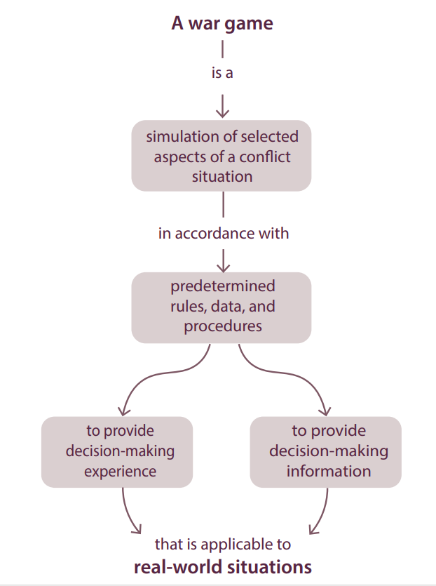
1) Analysis-Led Wargaming Framework
1) Discover & Define
2) Design Development
3) Execute
4) Analyse
5) Report
Milestones: ICM, CDM, FCM, Sign Contract, Funding Gate 1
Milestones: Progress Reviews, Playtests, Funding Gates
Milestones: Rehearse, Conduct (Collect)
Milestones: Present Findings
Milestones: Deliver Report
Commission: Aim, Purpose, Objectives, Timescale, Required Level of Assurance, Expectations, Responsibilities, Reporting, and Exploitation
Create & Refine: Ruleset, Model, Simulation, Adjudication, Processes, Components, Scenario, Roles, Data Capture & Analysis Plan
Identify: Participants, Venue, Tools, Technology
Iterate: Playtests increasing in complexity
Run Wargaming Activity: Rehearse, Conduct
Carry Out: After Action Review
Generate First Impressions: Unverified observations derived from initial review of raw data
Generate Findings: Verified outputs derived from the analytical approach
Deliver: Post Exercise Report
Commission: Aim, Purpose, Objectives, Timescale, Required Level of Assurance, Expectations, Responsibilities, Reporting, and Exploitation
Create & Refine: Ruleset, Model, Simulation, Adjudication, Processes, Components, Scenario, Roles, Data Capture & Analysis Plan
Identify: Participants, Venue, Tools, Technology
Iterate: Playtests increasing in complexity
Run Wargaming Activity: Rehearse, Conduct
Carry Out: After Action Review
Deliver Report: Present finalised findings, approach, methodology, and necessary caveats
Broadly applicable to wargames for a range of purposes
Conduct: Literature Review,
Games Review, Knowledge Survey, Lessons Survey
Identify: Gap or Problem in Understanding
Propose: Candidate Research Question (RQ) or Puzzle (RP)
Confirm: RQ or RP can be addressed by game
Create: Hypotheses or expectations
Identify and Confirm: Analytical approach and collection methods
Source: Required SQEP (Blue and Red)
Collect: Employ data collection methods
Assess: Employ analytical approach to collected data, moderate results, re-analyse to determine outputs
Verify Findings: Relate to RQ/P, Lit Review and/or Knowledge Survey and/or Lessons
(TTX)
Does not include analysis as a discrete part of the process
Identify: Appropriate assurance approach to ensure wargaming activity is fit for purpose, using either the Evidence Framework Approach (EFA) or Validity Framework Approach (VFA)
Benchmark: Use selected approach to assess required quality, validity, and confidence levels
Quality Assessment: Ensure accurate and comprehensive data are collected
Evaluate: Assess potential bias in outcomes by reviewing scenario diversity and credibility
Review: Present preliminary findings to Commissioner for validation
Assurance: Use selected approach to evaluate final quality, validity, and confidence levels
Refine
Impact
The Wargame Process:
MOD Wargaming Handbook
Evaluate Design: Identify lessons that could improve future wargame designs
Incorporate: Action lessons identified
Commissioner's Responsibility
Define: Exploitation route and execute
Assess: Impact/value-added by output
Delivery Activities
Analysis Activities
Assurance Activities
Note: Some activities and milestones may only apply to large-scale wargames

Slide 6
1) Analysis-Led Wargaming Framework
1) Discover & Define
2) Design Development
3) Execute
4) Analyse
5) Report
Milestones: ICM, CDM, FCM, Sign Contract, Funding Gate 1
Milestones: Progress Reviews, Playtests, Funding Gates
Milestones: Rehearse, Conduct (Collect)
Milestones: Present Findings
Milestones: Deliver Report
Commission: Aim, Purpose, Objectives, Timescale, Required Level of Assurance, Expectations, Responsibilities, Reporting, and Exploitation
Create & Refine: Ruleset, Model, Simulation, Adjudication, Processes, Components, Scenario, Roles, Data Capture & Analysis Plan
Identify: Participants, Venue, Tools, Technology
Iterate: Playtests increasing in complexity
Run Wargaming Activity: Rehearse, Conduct
Carry Out: After Action Review
Generate First Impressions: Unverified observations derived from initial review of raw data
Generate Findings: Verified outputs derived from the analytical approach
Deliver: Post Exercise Report
Commission: Aim, Purpose, Objectives, Timescale, Required Level of Assurance, Expectations, Responsibilities, Reporting, and Exploitation
Create & Refine: Ruleset, Model, Simulation, Adjudication, Processes, Components, Scenario, Roles, Data Capture & Analysis Plan
Identify: Participants, Venue, Tools, Technology
Iterate: Playtests increasing in complexity
Run Wargaming Activity: Rehearse, Conduct
Carry Out: After Action Review
Deliver Report: Present finalised findings, approach, methodology, and necessary caveats
Broadly applicable to wargames for a range of purposes
Conduct: Literature Review,
Games Review, Knowledge Survey, Lessons Survey
Identify: Gap or Problem in Understanding
Propose: Candidate Research Question (RQ) or Puzzle (RP)
Confirm: RQ or RP can be addressed by game
Create: Hypotheses or expectations
Identify and Confirm: Analytical approach and collection methods
Source: Required SQEP (Blue and Red)
Collect: Employ data collection methods
Assess: Employ analytical approach to collected data, moderate results, re-analyse to determine outputs
Verify Findings: Relate to RQ/P, Lit Review and/or Knowledge Survey and/or Lessons
(TTX)
Identify: Appropriate assurance approach to ensure wargaming activity is fit for purpose, using either the Evidence Framework Approach (EFA) or Validity Framework Approach (VFA)
Does not include analysis as a discrete part of the process
Review: Present preliminary findings to Commissioner for validation
Assurance: Use selected approach to evaluate final quality, validity, and confidence levels
Benchmark: Use selected approach to assess required quality, validity, and confidence levels
Quality Assessment: Ensure accurate and comprehensive data are collected
Evaluate: Assess potential bias in outcomes by reviewing scenario diversity and credibility
Refine
Impact
The Wargame Process:
MOD Wargaming Handbook
Evaluate Design: Identify lessons that could improve future wargame designs
Incorporate: Action lessons identified
Commissioner's Responsibility
Define: Exploitation route and execute
Assess: Impact/value-added by output
Delivery Activities
Analysis Activities
Assurance Activities
Note: Some activities and milestones may only apply to large-scale wargames

Slide 7
1) Analysis-Led Wargaming Framework
1) Discover & Define
2) Design Development
3) Execute
4) Analyse
5) Report
Milestones: ICM, CDM, FCM, Sign Contract, Funding Gate 1
Milestones: Progress Reviews, Playtests, Funding Gates
Milestones: Rehearse, Conduct (Collect)
Milestones: Present Findings
Milestones: Deliver Report
Commission: Aim, Purpose, Objectives, Timescale, Required Level of Assurance, Expectations, Responsibilities, Reporting, and Exploitation
Create & Refine: Ruleset, Model, Simulation, Adjudication, Processes, Components, Scenario, Roles, Data Capture & Analysis Plan
Identify: Participants, Venue, Tools, Technology
Iterate: Playtests increasing in complexity
Run Wargaming Activity: Rehearse, Conduct
Carry Out: After Action Review
Generate First Impressions: Unverified observations derived from initial review of raw data
Generate Findings: Verified outputs derived from the analytical approach
Deliver: Post Exercise Report
Commission: Aim, Purpose, Objectives, Timescale, Required Level of Assurance, Expectations, Responsibilities, Reporting, and Exploitation
Create & Refine: Ruleset, Model, Simulation, Adjudication, Processes, Components, Scenario, Roles, Data Capture & Analysis Plan
Identify: Participants, Venue, Tools, Technology
Iterate: Playtests increasing in complexity
Run Wargaming Activity: Rehearse, Conduct
Carry Out: After Action Review
Deliver Report: Present finalised findings, approach, methodology, and necessary caveats
Broadly applicable to wargames for a range of purposes
Conduct: Literature Review,
Games Review, Knowledge Survey, Lessons Survey
Identify: Gap or Problem in Understanding
Propose: Candidate Research Question (RQ) or Puzzle (RP)
Confirm: RQ or RP can be addressed by game
Create: Hypotheses or expectations
Identify and Confirm: Analytical approach and collection methods
Source: Required SQEP (Blue and Red)
Collect: Employ data collection methods
Assess: Employ analytical approach to collected data, moderate results, re-analyse to determine outputs
Verify Findings: Relate to RQ/P, Lit Review and/or Knowledge Survey and/or Lessons
(TTX)
Identify: Appropriate assurance approach to ensure wargaming activity is fit for purpose, using either the Evidence Framework Approach (EFA) or Validity Framework Approach (VFA)
Does not include analysis as a discrete part of the process
Review: Present preliminary findings to Commissioner for validation
Assurance: Use selected approach to evaluate final quality, validity, and confidence levels
Benchmark: Use selected approach to assess required quality, validity, and confidence levels
Quality Assessment: Ensure accurate and comprehensive data are collected
Evaluate: Assess potential bias in outcomes by reviewing scenario diversity and credibility
Refine
Impact
The Wargame Process:
MOD Wargaming Handbook
Evaluate Design: Identify lessons that could improve future wargame designs
Incorporate: Action lessons identified
Commissioner's Responsibility
Define: Exploitation route and execute
Assess: Impact/value-added by output
Delivery Activities
Analysis Activities
Assurance Activities
Note: Some activities and milestones may only apply to large-scale wargames

Slide 8
1) Analysis-Led Wargaming Framework
1) Discover & Define
2) Design Development
3) Execute
4) Analyse
5) Report
Milestones: ICM, CDM, FCM, Sign Contract, Funding Gate 1
Milestones: Progress Reviews, Playtests, Funding Gates
Milestones: Rehearse, Conduct (Collect)
Milestones: Present Findings
Milestones: Deliver Report
Commission: Aim, Purpose, Objectives, Timescale, Required Level of Assurance, Expectations, Responsibilities, Reporting, and Exploitation
Create & Refine: Ruleset, Model, Simulation, Adjudication, Processes, Components, Scenario, Roles, Data Capture & Analysis Plan
Identify: Participants, Venue, Tools, Technology
Iterate: Playtests increasing in complexity
Run Wargaming Activity: Rehearse, Conduct
Carry Out: After Action Review
Generate First Impressions: Unverified observations derived from initial review of raw data
Generate Findings: Verified outputs derived from the analytical approach
Deliver Report: Present finalised findings, approach, methodology, and necessary caveats
Commission: Aim, Purpose, Objectives, Timescale, Required Level of Assurance, Expectations, Responsibilities, Reporting, and Exploitation
Create & Refine: Ruleset, Model, Simulation, Adjudication, Processes, Components, Scenario, Roles, Data Capture & Analysis Plan
Identify: Participants, Venue, Tools, Technology
Iterate: Playtests increasing in complexity
Run Wargaming Activity: Rehearse, Conduct
Carry Out: After Action Review
Generate First Impressions: Unverified observations derived from initial review of raw data
Generate Findings: Verified outputs derived from the analytical approach
Deliver: Post Exercise Report
Commission: Aim, Purpose, Objectives, Timescale, Required Level of Assurance, Expectations, Responsibilities, Reporting, and Exploitation
Create & Refine: Ruleset, Model, Simulation, Adjudication, Processes, Components, Scenario, Roles, Data Capture & Analysis Plan
Identify: Participants, Venue, Tools, Technology
Iterate: Playtests increasing in complexity
Run Wargaming Activity: Rehearse, Conduct
Carry Out: After Action Review
Deliver Report: Present finalised findings, approach, methodology, and necessary caveats
Conduct: Literature Review,
Games Review, Knowledge Survey, Lessons Survey
Identify: Gap or Problem in Understanding
Propose: Candidate Research Question (RQ) or Puzzle (RP)
Confirm: RQ or RP can be addressed by game
Create: Hypotheses or expectations
Identify and Confirm: Analytical approach and collection methods
Source: Required SQEP (Blue and Red)
Collect: Employ data collection methods
Assess: Employ analytical approach to collected data, moderate results, re-analyse to determine outputs
Verify Findings: Relate to RQ/P, Lit Review and/or Knowledge Survey and/or Lessons
(TTX)
Identify: Appropriate assurance approach to ensure wargaming activity is fit for purpose, using either the Evidence Framework Approach (EFA) or Validity Framework Approach (VFA)
Benchmark: Use selected approach to assess required quality, validity, and confidence levels
Quality Assessment: Ensure accurate and comprehensive data are collected
Evaluate: Assess potential bias in outcomes by reviewing scenario diversity and credibility
Review: Present preliminary findings to Commissioner for validation
Assurance: Use selected approach to evaluate final quality, validity, and confidence levels
Refine
Impact
Evaluate Design: Identify lessons that could improve future wargame designs
Incorporate: Action lessons identified
Commissioner's Responsibility
Define: Exploitation route and execute
Assess: Impact/value-added by output
Delivery Activities
Analysis Activities
Assurance Activities
Note: Some activities and milestones may only apply to large-scale wargames
Delivery Activities

Slide 9
1) Analysis-Led Wargaming Framework
1) Discover & Define
2) Design Development
3) Execute
4) Analyse
5) Report
Milestones: ICM, CDM, FCM, Sign Contract, Funding Gate 1
Milestones: Progress Reviews, Playtests, Funding Gates
Milestones: Rehearse, Conduct (Collect)
Milestones: Present Findings
Milestones: Deliver Report
Commission: Aim, Purpose, Objectives, Timescale, Required Level of Assurance, Expectations, Responsibilities, Reporting, and Exploitation
Create & Refine: Ruleset, Model, Simulation, Adjudication, Processes, Components, Scenario, Roles, Data Capture & Analysis Plan
Identify: Participants, Venue, Tools, Technology
Iterate: Playtests increasing in complexity
Run Wargaming Activity: Rehearse, Conduct
Carry Out: After Action Review
Generate First Impressions: Unverified observations derived from initial review of raw data
Generate Findings: Verified outputs derived from the analytical approach
Deliver: Post Exercise Report
Commission: Aim, Purpose, Objectives, Timescale, Required Level of Assurance, Expectations, Responsibilities, Reporting, and Exploitation
Create & Refine: Ruleset, Model, Simulation, Adjudication, Processes, Components, Scenario, Roles, Data Capture & Analysis Plan
Identify: Participants, Venue, Tools, Technology
Iterate: Playtests increasing in complexity
Run Wargaming Activity: Rehearse, Conduct
Carry Out: After Action Review
Deliver Report: Present finalised findings, approach, methodology, and necessary caveats
Conduct: Literature Review,
Games Review, Knowledge Survey, Lessons Survey
Identify: Gap or Problem in Understanding
Propose: Candidate Research Question (RQ) or Puzzle (RP)
Confirm: RQ or RP can be addressed by game
Create: Hypotheses or expectations
Identify and Confirm: Analytical approach and collection methods
Source: Required SQEP (Blue and Red)
Collect: Employ data collection methods
Assess: Employ analytical approach to collected data, moderate results, re-analyse to determine outputs
Verify Findings: Relate to RQ/P, Lit Review and/or Knowledge Survey and/or Lessons
Conduct: Literature Review,
Games Review, Knowledge Survey, Lessons Survey
Identify: Gap or Problem in Understanding
Propose: Candidate Research Question (RQ) or Puzzle (RP)
Confirm: RQ or RP can be addressed by game
Create: Hypotheses or expectations
Identify and Confirm: Analytical approach and collection methods
Source: Required SQEP (Blue and Red)
Collect: Employ data collection methods
Assess: Employ analytical approach to collected data, moderate results, re-analyse to determine outputs
Verify Findings: Relate to RQ/P, Lit Review and/or Knowledge Survey and/or Lessons
Commission: Aim, Purpose, Objectives, Timescale, Required Level of Assurance, Expectations, Responsibilities, Reporting, and Exploitation
Create & Refine: Ruleset, Model, Simulation, Adjudication, Processes, Components, Scenario, Roles, Data Capture & Analysis Plan
Identify: Participants, Venue, Tools, Technology
Iterate: Playtests increasing in complexity
Run Wargaming Activity: Rehearse, Conduct
Carry Out: After Action Review
Generate First Impressions: Unverified observations derived from initial review of raw data
Generate Findings: Verified outputs derived from the analytical approach
Deliver Report: Present finalised findings, approach, methodology, and necessary caveats
(TTX)
Identify: Appropriate assurance approach to ensure wargaming activity is fit for purpose, using either the Evidence Framework Approach (EFA) or Validity Framework Approach (VFA)
Benchmark: Use selected approach to assess required quality, validity, and confidence levels
Quality Assessment: Ensure accurate and comprehensive data are collected
Evaluate: Assess potential bias in outcomes by reviewing scenario diversity and credibility
Review: Present preliminary findings to Commissioner for validation
Assurance: Use selected approach to evaluate final quality, validity, and confidence levels
Refine
Impact
Evaluate Design: Identify lessons that could improve future wargame designs
Incorporate: Action lessons identified
Commissioner's Responsibility
Define: Exploitation route and execute
Assess: Impact/value-added by output
Delivery Activities
Analysis Activities
Note: Some activities and milestones may only apply to large-scale wargames
Delivery Activities
Analysis Activities
Assurance Activities
Notes:
Analysis activities set the conditions for the delivery activities and the game design

Slide 10
1) Analysis-Led Wargaming Framework
1) Discover & Define
2) Design Development
3) Execute
4) Analyse
5) Report
Milestones: ICM, CDM, FCM, Sign Contract, Funding Gate 1
Milestones: Progress Reviews, Playtests, Funding Gates
Milestones: Rehearse, Conduct (Collect)
Milestones: Present Findings
Milestones: Deliver Report
Commission: Aim, Purpose, Objectives, Timescale, Required Level of Assurance, Expectations, Responsibilities, Reporting, and Exploitation
Create & Refine: Ruleset, Model, Simulation, Adjudication, Processes, Components, Scenario, Roles, Data Capture & Analysis Plan
Identify: Participants, Venue, Tools, Technology
Iterate: Playtests increasing in complexity
Run Wargaming Activity: Rehearse, Conduct
Carry Out: After Action Review
Generate First Impressions: Unverified observations derived from initial review of raw data
Generate Findings: Verified outputs derived from the analytical approach
Deliver: Post Exercise Report
Commission: Aim, Purpose, Objectives, Timescale, Required Level of Assurance, Expectations, Responsibilities, Reporting, and Exploitation
Create & Refine: Ruleset, Model, Simulation, Adjudication, Processes, Components, Scenario, Roles, Data Capture & Analysis Plan
Identify: Participants, Venue, Tools, Technology
Iterate: Playtests increasing in complexity
Run Wargaming Activity: Rehearse, Conduct
Carry Out: After Action Review
Deliver Report: Present finalised findings, approach, methodology, and necessary caveats
Conduct: Literature Review,
Games Review, Knowledge Survey, Lessons Survey
Identify: Gap or Problem in Understanding
Propose: Candidate Research Question (RQ) or Puzzle (RP)
Confirm: RQ or RP can be addressed by game
Create: Hypotheses or expectations
Identify and Confirm: Analytical approach and collection methods
Source: Required SQEP (Blue and Red)
Collect: Employ data collection methods
Assess: Employ analytical approach to collected data, moderate results, re-analyse to determine outputs
Verify Findings: Relate to RQ/P, Lit Review and/or Knowledge Survey and/or Lessons
Conduct: Literature Review,
Games Review, Knowledge Survey, Lessons Survey
Identify: Gap or Problem in Understanding
Propose: Candidate Research Question (RQ) or Puzzle (RP)
Confirm: RQ or RP can be addressed by game
Create: Hypotheses or expectations
Identify and Confirm: Analytical approach and collection methods
Source: Required SQEP (Blue and Red)
Collect: Employ data collection methods
Assess: Employ analytical approach to collected data, moderate results, re-analyse to determine outputs
Verify Findings: Relate to RQ/P, Lit Review and/or Knowledge Survey and/or Lessons
(TTX)
Identify: Appropriate assurance approach to ensure wargaming activity is fit for purpose, using either the Evidence Framework Approach (EFA) or Validity Framework Approach (VFA)
Identify: Appropriate assurance approach to ensure wargaming activity is fit for purpose, using either the Evidence Framework Approach (EFA) or Validity Framework Approach (VFA)
Review: Present preliminary findings to Commissioner for validation
Review: Present preliminary findings to Commissioner for validation
Assurance: Use selected approach to evaluate final quality, validity, and confidence levels
Benchmark: Use selected approach to assess required quality, validity, and confidence levels
Assurance: Use selected approach to evaluate final quality, validity, and confidence levels
Benchmark: Use selected approach to assess required quality, validity, and confidence levels
Quality Assessment: Ensure accurate and comprehensive data are collected
Quality Assessment: Ensure accurate and comprehensive data are collected
Evaluate: Assess potential bias in outcomes by reviewing scenario diversity and credibility
Evaluate: Assess potential bias in outcomes by reviewing scenario diversity and credibility
Refine
Impact
Evaluate Design: Identify lessons that could improve future wargame designs
Incorporate: Action lessons identified
Commissioner's Responsibility
Define: Exploitation route and execute
Assess: Impact/value-added by output
Analysis Activities
Note: Some activities and milestones may only apply to large-scale wargames
Analysis Activities
Assurance Activities
Delivery Activities
Assurance Activities

Slide 11
1) Analysis-Led Wargaming Framework
1) Discover & Define
2) Design Development
3) Execute
4) Analyse
5) Report
Milestones: ICM, CDM, FCM, Sign Contract, Funding Gate 1
Milestones: Progress Reviews, Playtests, Funding Gates
Milestones: Rehearse, Conduct (Collect)
Milestones: Present Findings
Milestones: Deliver Report
Commission: Aim, Purpose, Objectives, Timescale, Required Level of Assurance, Expectations, Responsibilities, Reporting, and Exploitation
Create & Refine: Ruleset, Model, Simulation, Adjudication, Processes, Components, Scenario, Roles, Data Capture & Analysis Plan
Identify: Participants, Venue, Tools, Technology
Iterate: Playtests increasing in complexity
Run Wargaming Activity: Rehearse, Conduct
Carry Out: After Action Review
Generate First Impressions: Unverified observations derived from initial review of raw data
Generate Findings: Verified outputs derived from the analytical approach
Deliver: Post Exercise Report
Commission: Aim, Purpose, Objectives, Timescale, Required Level of Assurance, Expectations, Responsibilities, Reporting, and Exploitation
Create & Refine: Ruleset, Model, Simulation, Adjudication, Processes, Components, Scenario, Roles, Data Capture & Analysis Plan
Identify: Participants, Venue, Tools, Technology
Iterate: Playtests increasing in complexity
Run Wargaming Activity: Rehearse, Conduct
Carry Out: After Action Review
Deliver Report: Present finalised findings, approach, methodology, and necessary caveats
Conduct: Literature Review,
Games Review, Knowledge Survey, Lessons Survey
Identify: Gap or Problem in Understanding
Propose: Candidate Research Question (RQ) or Puzzle (RP)
Confirm: RQ or RP can be addressed by game
Create: Hypotheses or expectations
Identify and Confirm: Analytical approach and collection methods
Source: Required SQEP (Blue and Red)
Collect: Employ data collection methods
Assess: Employ analytical approach to collected data, moderate results, re-analyse to determine outputs
Verify Findings: Relate to RQ/P, Lit Review and/or Knowledge Survey and/or Lessons
Identify: Appropriate assurance approach to ensure wargaming activity is fit for purpose, using either the Evidence Framework Approach (EFA) or Validity Framework Approach (VFA)
Benchmark: Use selected approach to assess required quality, validity, and confidence levels
Quality Assessment: Ensure accurate and comprehensive data are collected
Evaluate: Assess potential bias in outcomes by reviewing scenario diversity and credibility
Review: Present preliminary findings to Commissioner for validation
Assurance: Use selected approach to evaluate final quality, validity, and confidence levels
(TTX)
Identify: Appropriate assurance approach to ensure wargaming activity is fit for purpose, using either the Evidence Framework Approach (EFA) or Validity Framework Approach (VFA)
Benchmark: Use selected approach to assess required quality, validity, and confidence levels
Quality Assessment: Ensure accurate and comprehensive data are collected
Evaluate: Assess potential bias in outcomes by reviewing scenario diversity and credibility
Review: Present preliminary findings to Commissioner for validation
Assurance: Use selected approach to evaluate final quality, validity, and confidence levels
Refine
Impact
Evaluate Design: Identify lessons that could improve future wargame designs
Incorporate: Action lessons identified
Commissioner's Responsibility
Define: Exploitation route and execute
Assess: Impact/value-added by output
Analysis Activities
Assurance Activities
Note: Some activities and milestones may only apply to large-scale wargames
Assurance Activities
Delivery Activities
Assurance Activities

Slide 12
2) Wargame Commissioning Protocol
Aim
Generate a shared and comprehensive understanding of the requirement prior to commencing Design and Development
Output
A Commissioning Contract between the delivery organisation and Commissioner
Pathway
  Initial Commissioning Meeting (ICM)
  Concept Development Meeting (CDM)
  Final Commissioning Meeting (FCM)
  Contract

Slide 13
2) Wargame Commissioning Protocol
Aim
Generate a shared and comprehensive understanding of the requirement prior to commencing Design and Development
Output
A Commissioning Contract between the delivery organisation and Commissioner
Pathway
  Initial Commissioning Meeting (ICM)
  Concept Development Meeting (CDM)
  Final Commissioning Meeting (FCM)
  Contract

Slide 14
ICM
  Present commissioning protocol document
  Educate commissioner
  Answer questions to generate a coherent wargaming specific requirement
  Communicate process, expectations, and roles and responsibilities

Slide 15
Question 1 – Owner:
Who is commissioning the wargame?
Question 2 – Function:
What do you want the wargame to do?
Question 3 – Requirement:
What do you want the wargame to reveal?
Question 4 – Knowledge Baseline:
What is already known that needs to be reflected in the wargame?
Notes:
1) Who is commissioning the game?
The Commissioner of a game is defined as: The senior official/officer who owns the decision associated with the game’s output and who has the influence to ensure the game is sufficiently well-supported to be rigorous (normally 1*+).
It is his or her:
Question/issue that the game seeks to answer or address;
Frame of reference that the game primarily adopts;
Responsibility to ensure the DEWH Project Team understand the context of the question/issue to be addressed;
Responsibility to ensure the timely provision of the information, support and players required by DEWH to deliver a suitably insightful game.
Desired game function - 2) What do you want the game to do?
Noting each requires a different approach and should not be mixed in the same game:
Stress Test (something that already exists - plan, policy, strategy etc);
Frame (something that doesn’t already exist – plan, policy, strategy etc);
Explore (build further/deeper/greater understanding, exchange knowledge etc via group analysis in a seminar format. To identify problem areas and defines next steps);
Analyse (generate new knowledge or insight on a particular issue/question. To explore an hypothesis, answer a research question, examine the consequences of a specific decision or COA);
Influence (message a particular audience);
Something else …
Desired game requirement - 3) What do you want the game to reveal?
An answer to a Master Question (MQ) or Research Question (RQ):
Master Questions can be explored via structured discussion and analysis;
Research Questions require the generation of new data, via a suitable model, for subsequent analysis.
The validity (or otherwise) of an hypothesis:
If (we do that) then (this will/will not happen);
X (will not happen) until Y (has been achieved);
The answer to a puzzle:
We think this happens because …
We have no idea why this happens … but would like to;
An assessment of something: efficacy, viability, understanding etc;
Knowledge baseline - 4) What is already known that needs to be reflected in the game?
In the literature (what literature)?
By SMEs (which SMEs)?
In Lessons Identified or other databases (such as Post Exercise Reports)?
Is this knowledge available in a collated form and, if so, where?
Is there a requirement for a Literature Review and if so:
What type: Thematic, Integrative, Critical?
Which sources: Primary, Secondary, Tertiary?
Is there a requirement for a Knowledge Survey and if so, who has this knowledge?

Slide 16
Question 5 – Constraints:
What does the Commissioner expect the wargame to not challenge? (Out of scope)
Question 6 – Assumptions:
What does the Commissioner expect the wargame to assume? (In scope)
Question 7 – Output:
What format of reporting is required and when?
Notes:
Report format - 5) What format of report is required and when?
Noting report format is linked to receiving timeline and breadth of analysis required – a swift report and full analysis are incompatible.
Formats:
Written: project style - capturing the route to, evidence generated by and output of game;
Written: brief style (capturing key issues only, no narrative, no evidence);
Slides: project or brief style;
Presentation with slides: project or brief style.
Others tbc …

Slide 17
Question 8 – Analysis Requirement:
What level of insight (new knowledge) does the Commissioner want from the wargame?

Slide 18
Question 8: What level of insight (new knowledge) does the Commissioner want from the wargame?
Level | Description
4 | Self-capture of conversation and opinion (i.e. no analysis)
3 | Collated capture of conversation and opinion (i.e. what was said, organised by theme, framework etc.)
2 | Findings (i.e. application of a narrow range of analytical techniques to determine what new knowledge was derived from the game. May offer correlation)
1 | Conclusions (i.e. Level 2 + application of a broad range of analytical techniques to determine what new knowledge was derived from the game. May offer correlation and causality)
The greater the risk associated with the wargame outcome, the higher the level of analysis should be

Slide 19
Question 8 – Analysis Requirement:
What level of insight (new knowledge) does the Commissioner want from the wargame?
Question 9 – Assurance Levels:
How will the outputs be used and thus what level of assurance does the commissioner seek in the wargame’s output?

Slide 20
Question 9.1: How will the outputs be used and thus what level of assurance does the commissioner seek in the output? Noting that achieving a high assurance level generally suggests Level 3+ analysis
Usage | Suggested Assurance Level
Exploratory: Output will be one of many inputs to a decision. | Low: Partial Validity Framework Approach (pVFA)
Informative: Output will be one of several inputs to a decision. | Moderate: Full Validity Framework Approach or partial Evidence Framework Approach (pEFA)
Definitive: Output will be a primary input to a decision. | High: Full Evidence Framework Approach (EFA)

Slide 21
Question 9.2: What is the required level of generalisability?
The degree to which the findings of the wargaming activity can be reliably applied to other settings/conditions.
Generalisability Level | Description of Outputs
3: Low | Highly context-specific Can only be applied in very similar circumstances without significant moderation
2: Moderate | Can be applied in contexts that are similar Will require careful tailoring and adjustments if applied to different contexts
1: High | Can be applied broadly Demonstrate strong applicability to a wide range of circumstances Minimal caution needed for contextual adaptation

Slide 22
Question 8 – Analysis Requirement:
What level of insight (new knowledge) does the Commissioner want from the wargame?
Question 9 – Assurance Levels:
How will the outputs be used and thus what level of assurance does the commissioner seek in the wargame’s output?
Question 10 – Levels of Realism:
What kind of decision-making do you want the wargaming activity to emphasise?

